Slide 1
MARKET RESEARCH ANALYSIS
CSIRO TEXT ANNOTATION TOOL
CSIRO GROUP 1
TRIMESTER 1 2019

Slide 2
PRESENTATION BY
Degala Anurag Yadav
Harsha Lakshmipuram
Amelia Wigg
Malayamarutham Sai Pradyumna
Sai Gautam Mandapati
Pavani Gujjarlapudi
Eswar Sai Krishna Gowra
Tharindhu Chamara

Slide 3
PRESENTATION OUTLINE
Cover Page
Contents
Aims and Deliverables
Target Market and Need
Competitor Analysis
Tool 1: Bioportal
Bioportal S + W
Bioportal Costs + Compatibility
Tool 2: Lightag
Lightag S + W
Lightag Costs + Compatibility
Tool 3: TagTog
TagTog S + W
TagTog costs + Compatibility
Tool 4: Diigo
Diigo S + W
Diigo Costs + Compatibility
Feasibility Analysis
Recommendations
The Team
References

Slide 4
AIMS + DELIVERABLES
Aims
To develop a web service that annotates text with definitions, taken from controlled online vocabulary services.
Provided by a collaboration of online vocabulary services.
A quick understanding, which is enabled by hyperlinking technical terms to their corresponding definitions.
Deliverables
Design Document
Diagrams
Sprint Management.
Market Research Analysis

Slide 5
Target market + target need
Target Market
The target market of our tool includes anyone who is undertaking online research using the internet.
The target market must be old enough to be undertaking research.
Target Need
Description of the tool.
Need for this tool.
Demand of this tool.

Slide 6
Competitor analysis
Four of the most similar and compatible tools have been chosen and outlined in the coming slides.
These tools include: Bioportal, Lightag, TagTog and Diigo.
The description of the tool as well as benefits, drawbacks, costs and alignment with our aims/deliverables will be analysed.

Slide 7
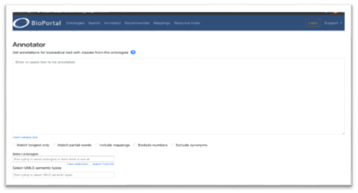
Tool 1: bioportal
Description:
Bioportal is a bio ontology website which assists in annotating words by providing links for various different websites, in which the user can obtain meanings and definitions of words.

Slide 8
Bioportal benefits + drawbacks
Benefits
Free web page annotation tool
Advance search options available based on databases
Customisation options according to user queries
Easy to use and handle
Get recommendations for the input query we provided
Drawbacks
We can search only ontology & Biomedical bases keywords
Limited to Biomedical uses not compatible all fields

Slide 9
Bioportal costs + compatibility
Costs
Bioportal annotator is an open source tool, free for anyone to use at no cost. There is a login option where user is able to create their account and download the latest versions of ontologies for their work.
Compatibility
The most important feature that aligns with aim and deliverables is the annotator. As our project is based around the features and uses of text annotation. We will integrate two API’s from the existing ontology libraries and develop an annotator.

Slide 10
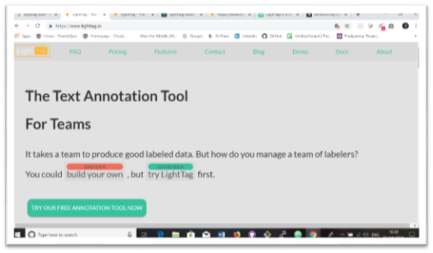
Tool 2: lightTag
Description
LightTag is a useful text annotation website/tool. It is predominantly used as text annotation platform for data scientists creating AI training data. LightTag aims to solve one of the main bottlenecks of the deep learning-based AI development.

Slide 11
Lightag benefits + Drawbacks
Benefits
Can annotate in any language
Measures inter annotator agreement to understand the quality of annotation
Continuously boot straps the projects and provides suggestions
Can add new meaning from our own library and upload it to LightTag with Rest API
Drawbacks
Provides hourly rate for engineers to build own labelling tools
Comes with only in on-premise version

Slide 12
lightag costs + compatibility
Costs
The tool is It is free of cost and only requires the user to create an account in order to use the tool. The tool can be downloaded and is especially useful for team projects.
Compatibility
Annotation capabilities which are similar to our aims. Some of the annotation or user features could be similarly designed in our project, although Lightag is aimed at AI, which our project does not have much focus on.

Slide 13
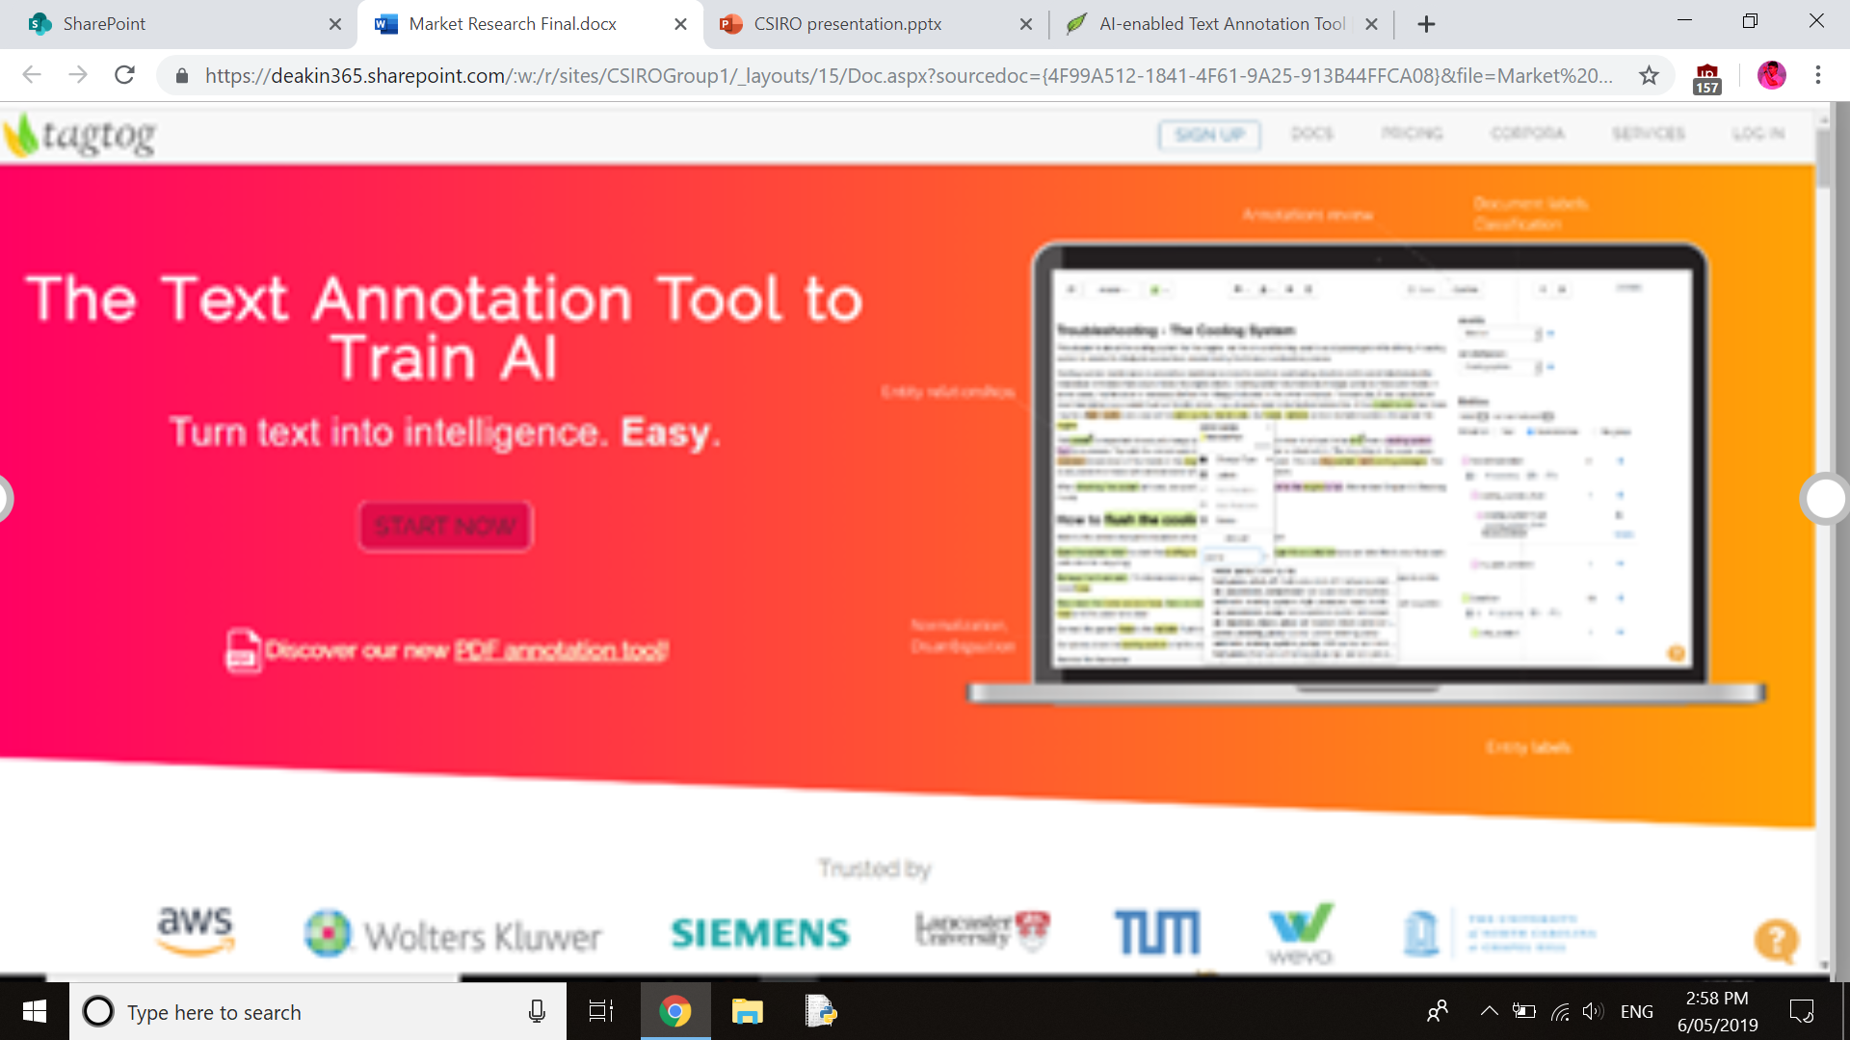
Tool 3: TAGTOG
Is an annotation tool that is designed to annotate and correct annotated works from a range of different fields
The tool delivers data in desired annotated format

Slide 14
tagtog benefits + drawbacks
Benefits
Can be used for ontology development
Highly customisable
Works with datasets from a range of different fields
Can annotate specialised text or create annotated corpus
Drawbacks
It requires monthly payments
It is quite a complex tool that is based on training algorithms

Slide 15
tagtog costs + compatibility
Costs
Tagtog offers a range of packages depending on the features required
The basic packages can either be privately hosted or hosted on Tagtog’s cloud
All packages require a monthly subscription
Compatibility
The tool of is freely available for anyone to use and can be downloaded by anyone.
The tool uses analytical capabilities that align with our projects analytical requirements

Slide 16
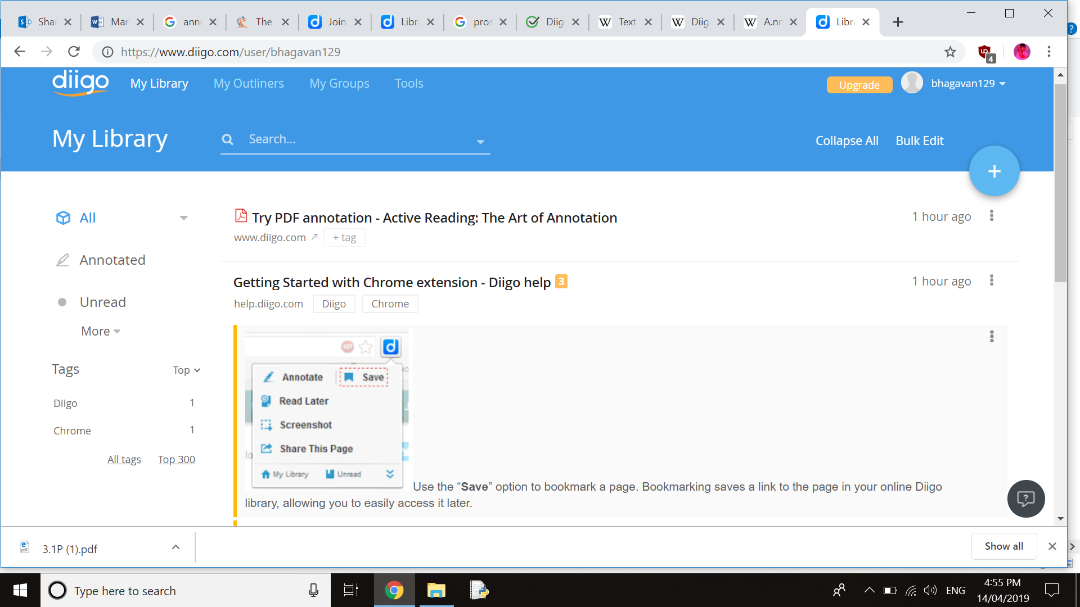
Tool 4: Diigo
Description
It is one of the most commonly used tools for web annotation, which allows the user to bookmark and tag web pages. In addition, the user is able to highlight a part of a webpage to add emphasis or a sticky note can be added.

Slide 17
DIIGO BENEFITS + DRAWBACKS
Benefits
Is an easy to download extension for the users web browser
It allows the user to annotate webpages as they browse online
Users can highlight passages of text to reference or for collaboration
Drawbacks
To gain all Diigo features, the user must pay a yearly subscription to keep using the different of features

Slide 18
DIIGO COSTS + Compatibility
Costs
There are a range of packages depending on the desired features
There a free package that involves the main features
Packages have a flat yearly fee depending on the features
Compatibility
The analytical features align with our project aims
The ability to create a personal library or collection of data aligns with our aims

Slide 19
Feasibility analysis
Based on initial understanding of the basic requirements of the tool that is to be developed and the research undertaken into other relevant tools, it appears that the development of analytical text tool is feasible.
However, there are similar tools that meet many of the requirements.
There are benefits of developing a new tool from scratch in order to ensure that all the requirements are met and all the features align with the tools purpose.
A cost/benefit analysis would be a good step in determining the certainty of a financial payoff, however simply based of the information available at this point in time, a new tool could be foundationally modelled off the most similar existing tool and adjusted and developed to supersede the original and meet all requirements.
This conclusion however is based solely off the information provided and therefore cannot take into consideration the availability and longevity of finances.

Slide 20
Recommendations
Our primary recommendation is to undertake a cost benefit analysis of developing a new tool, rather than alter an existing an open source tool
Based on research it would be more beneficial to alter an existing tool than spend time, money and resources developing a tool from scratch.
Based on these facts our recommendation would be to use Bioportal as a base, in which you could build your own ontologies and dictionaries of different terms
Additional features could be added to align with the project aims

Slide 21
References
Bioportal.bioontology.org. (2019). Welcome to the NCBO BioPortal | NCBO BioPortal. [online] Available at: https://bioportal.bioontology.org/ [Accessed 5 May 2019].
Medium. (2019). Announcing LightTag — The easy way to Annotate text. [online] Available at: https://medium.com/@TalPerry/announcing-lighttag-the-easy-way-to-annotate-text-afb7493a49b8 [Accessed 6 May 2019].
"AI-enabled Text Annotation Tool | PDF, Markdown, CSV, html, tweets, & many more types of Documents", Tagtog.net, 2019. [Online]. Available: https://www.tagtog.net/. [Accessed: 08- Apr- 2019].
Social Annotations, Highlighting and Social Bookmarking, retrieved 4 July 2006, <https://www.diigo.com/>

